Slide 1
App Engine Channels

Slide 2
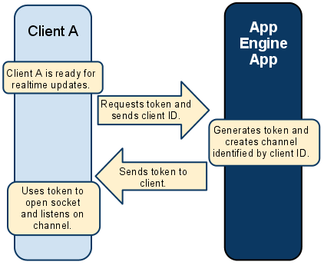

Slide 3
https://cloud.google.com/appengine/docs/go/channel/

Slide 4
App Engine Channels
The Channel API creates a persistent connection between your application and Google servers, allowing your application to send messages to JavaScript clients in real time without the use of polling.
This is useful for applications designed to update users about new information immediately.
Some example use-cases include collaborative applications, multi-player games, or chat rooms.
In general, using the Channel API is a better choice than polling in situations where updates can't be predicted or scripted, such as when relaying information between human users or from events not generated systematically.

Slide 5
Elements of the Channel API
Javascript client
The server
The client ID
Tokens
The channel
The message
Socket
Presence

Slide 6
Elements of the Channel API
Javascript client
The server
The client ID
Tokens
The channel
The message
Socket
Presence
The user interacts with a JavaScript client built into a webpage. The JavaScript client:
Connects to the channel once it receives the channel’s unique token from the server
Listens on the channel for updates regarding other clients and makes appropriate use of the data (e.g. updating the interface, etc.)
Sends update-messages to the server so they may be passed on to remote clients

Slide 7
Elements of the Channel API
Javascript client
The server
The client ID
Tokens
The channel
The message
Socket
Presence
Creates a unique channel for individual JavaScript clients
Creates and sends a unique token to each JavaScript client so they may connect and listen to their channel
Receives update-messages from clients via HTTP requests
Sends update-messages to clients via their channels
Optionally, manages client connection state.

Slide 8
Elements of the Channel API
Javascript client
The server
The client ID
Tokens
The channel
The message
Socket
Presence
The Client ID is responsible for identifying individual JavaScript clients on the server.
The server knows what channel on which to send a particular message because of the Client ID.
A Client ID can be anything that makes sense in the design of your application. For example, you can use something like cookie or login information, randomized numerical ID, or a user-selected name.
You may also create Client IDs in whatever way makes sense in your application. For example, you may choose to create the Client ID on the client and pass it to the server in an explicit request for a token, or create it on the server and inject it into the page’s HTML when the server replies to the browser’s request for the page.

Slide 9
Elements of the Channel API
Javascript client
The server
The client ID
Tokens
The channel
The message
Socket
Presence
Tokens are responsible for allowing the JavaScript Client to connect and listen to the channel created for it.
The server creates one token for each client using information such as the client’s Client ID and expiration time.
Tokens expire after two hours and should also be treated as secret.

Slide 10
Elements of the Channel API
Javascript client
The server
The client ID
Tokens
The channel
The message
Socket
Presence
A channel is a one-way communication path through which the server sends updates to a specific JavaScript client identified by its Client ID.
The server receives updates from clients via HTTP requests, then sends the messages to relevant clients via their channels.

Slide 11
Elements of the Channel API
Javascript client
The server
The client ID
Tokens
The channel
The message
Socket
Presence
Messages are sent via HTTP requests from one client to the server.
Once received, the server passes the message to the designated client via the correct channel identified by the Client ID.
Messages are limited to 32K.

Slide 12
Elements of the Channel API
Javascript client
The server
The client ID
Tokens
The channel
The message
Socket
Presence
The JavaScript client opens a socket using the token provided by the server. It uses the socket to listen for updates on the channel.

Slide 13
Elements of the Channel API
Javascript client
The server
The client ID
Tokens
The channel
The message
Socket
Presence
The server can register to receive a notification when a client connects to or disconnects from a channel.

Slide 14
